Slide 1

임베디드 시스템 Final Presentation
Inverted Pendulum
20510046 박동규

Slide 2
INDEX
System Modeling & Linearization
Porting State Feedback into Controller
Code Explanation
Result
Notes:
발표는 지금까지 진행한 내용과, 이후 진행할 내용을 간단히 말씀드리겠습니다.

Slide 3
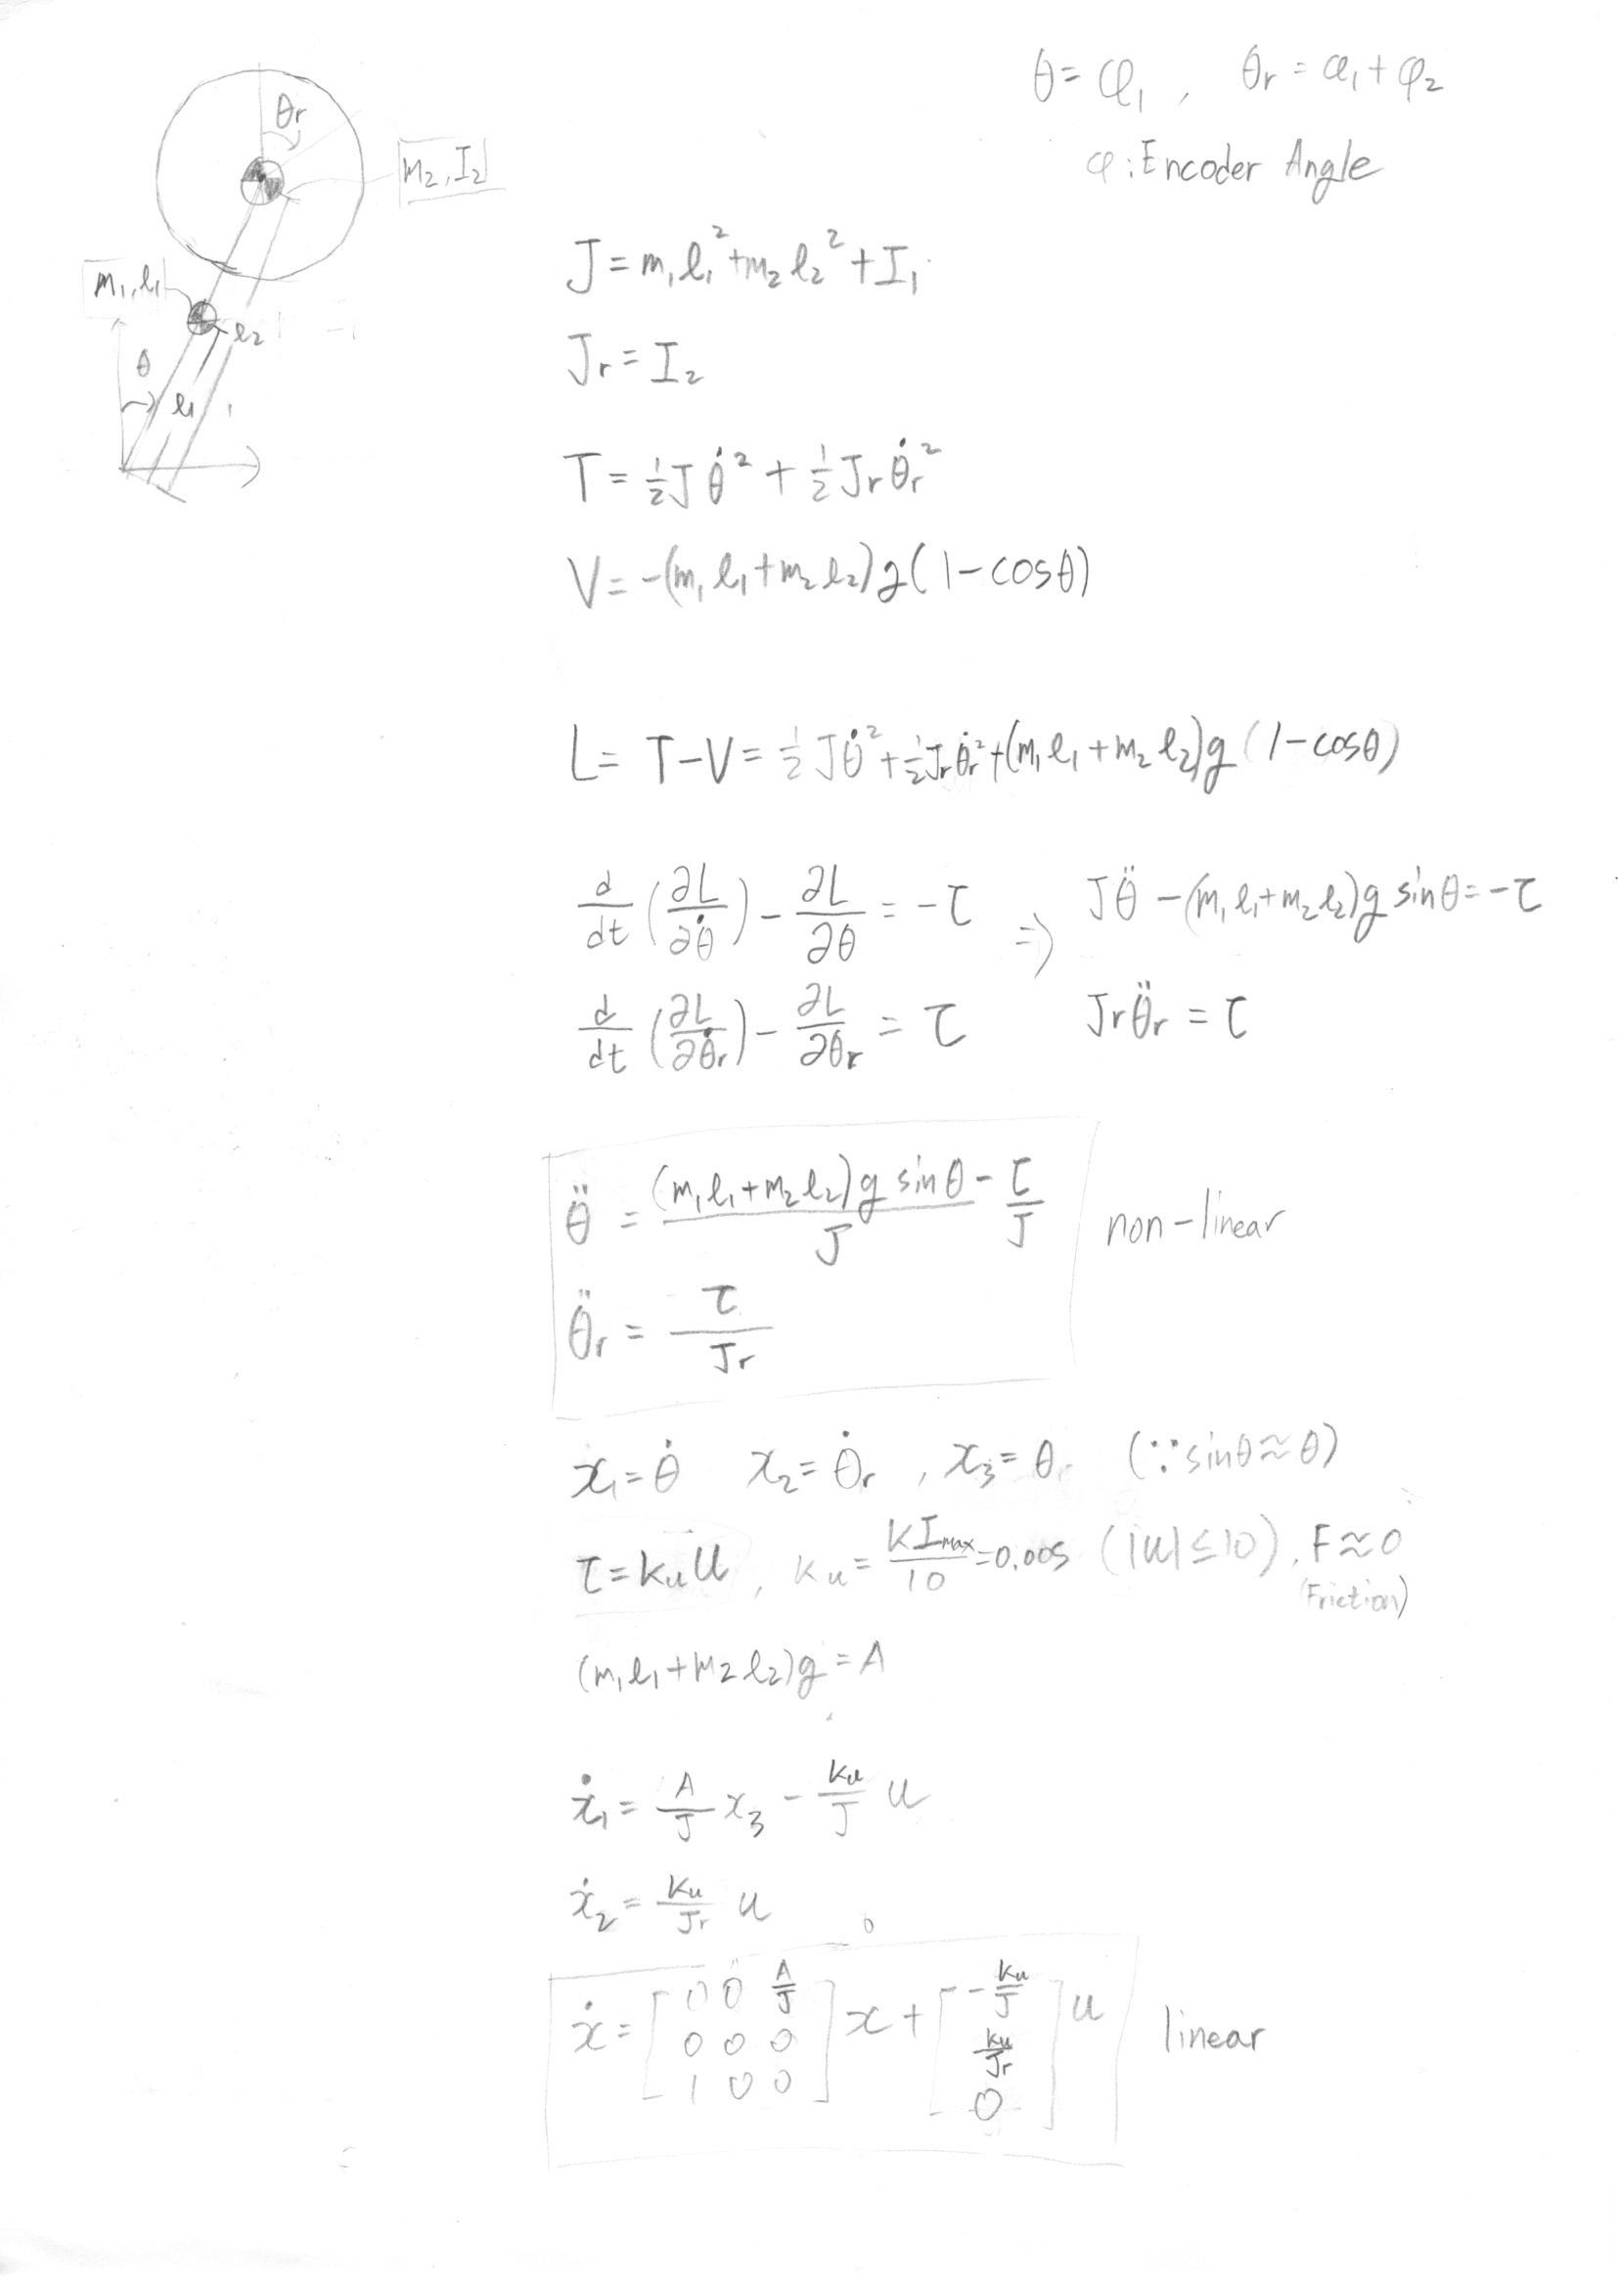
System Modeling & Linearization
System Modeling & Linearization

Slide 4
System Modeling & Linearization
System Modeling & Linearization

Slide 5
System Modeling & Linearization
System Modeling & Linearization

Slide 6
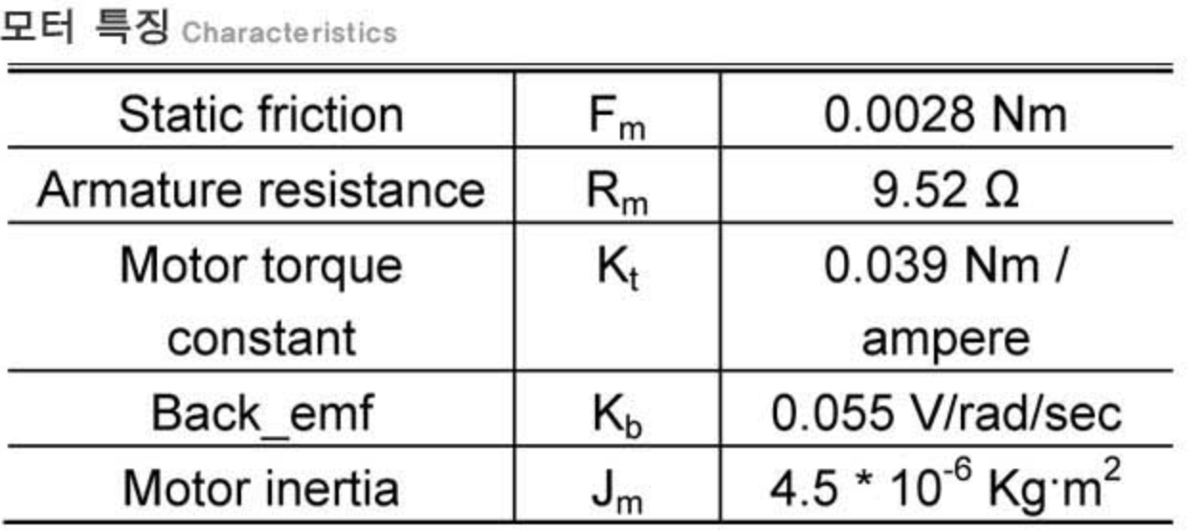
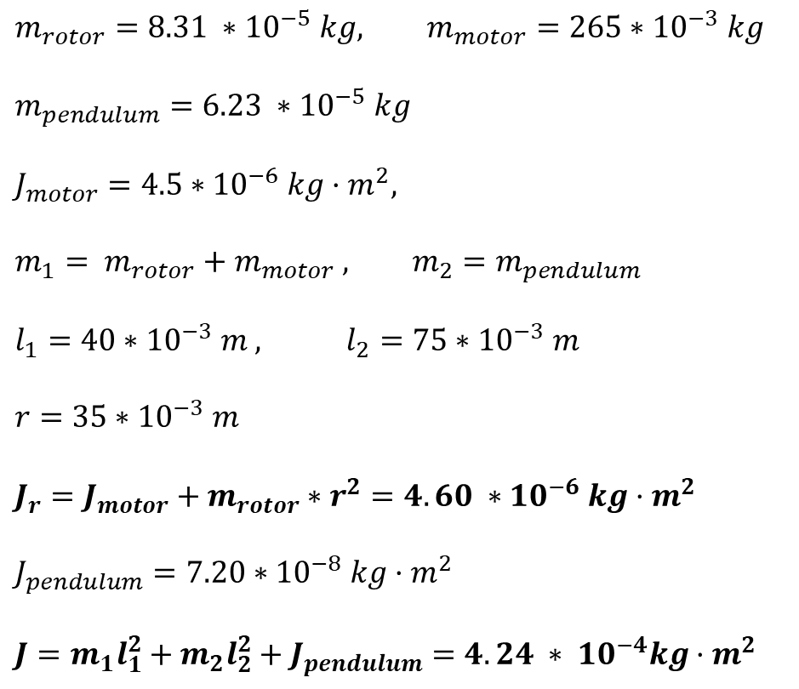
System Modeling & Linearization
System Modeling
$$m_{rotor}=8.31 ∗{10}^{−5} kg, m_{motor}=265∗{10}^{−3} kg$$
$$m_{pendulum}=6.23 ∗{10}^{−5} kg$$
$$J_{motor}=4.5∗{10}^{−6} kg·m^{2},$$
$$m_{1}= m_{rotor}+m_{motor} , m_{2}=m_{pendulum}$$
$$l_{1}=40∗{10}^{−3} m , l_{2}=75∗{10}^{−3} m$$
$r=35∗{10}^{−3} m$
$$J_{r}=J_{motor}+m_{rotor}∗r^{2}=4.60 ∗{10}^{−6} kg·m^{2}$$
$$J_{pendulum}=7.20∗{10}^{−8} kg·m^{2}$$
$$J=m_{1}l_{1}^{2}+m_{2}l_{2}^{2}+J_{pendulum}=4.24 ∗ {10}^{−4}kg·m^{2}$$

Slide 7
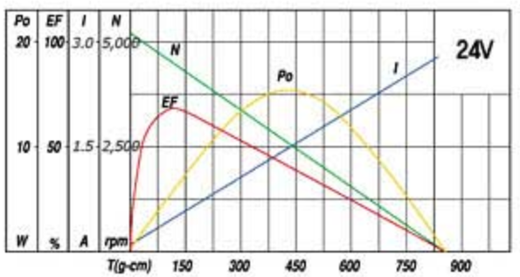
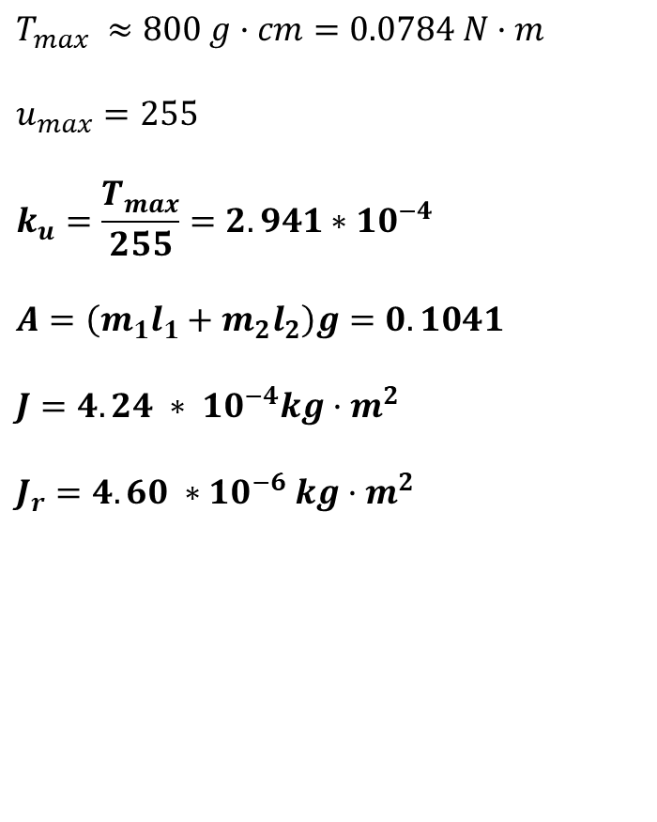
System Modeling & Linearization
System Modeling
$$T_{max} ≈800 g·cm=0.0784 N·m$$
$$u_{max}=255$$
$$k_{u}=\frac{T_{max}}{255}=2.941∗{10}^{−4}$$
$$A=\left(m_{1}l_{1}+m_{2}l_{2}\right)g=0.1041$$
$$J=4.24 ∗ {10}^{−4}kg·m^{2}$$
$$J_{r}=4.60 ∗{10}^{−6} kg·m^{2}$$

Slide 8
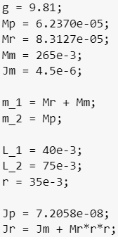
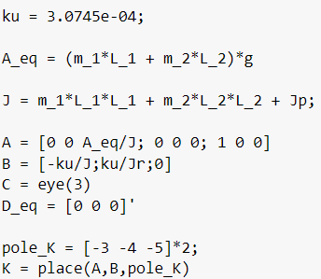
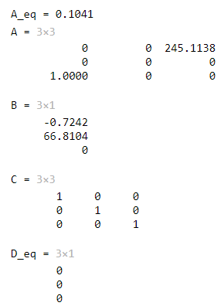
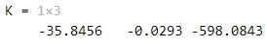
System Modeling & Linearization
System Modeling

Slide 9
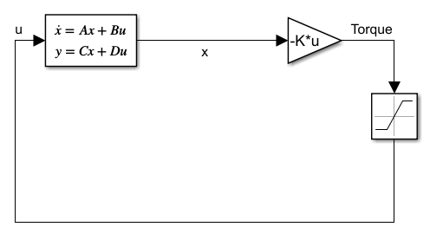
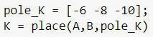
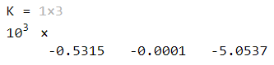
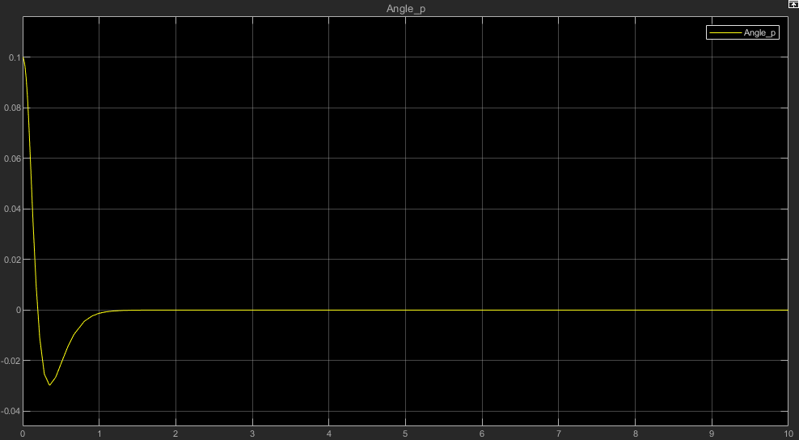
System Modeling & Linearization
Result – Full State Feedback

Slide 10
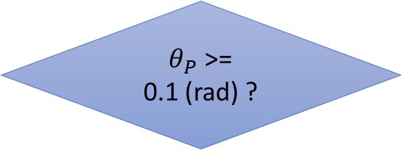
Porting State Feedback into Controller
Main Control Algorithm
$θ_{P}$ >= 0.1 (rad) ?
Stabilizing Move
N
Y
Swing-Up Move

Slide 11
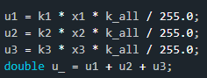
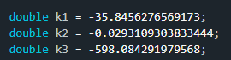
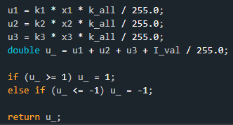
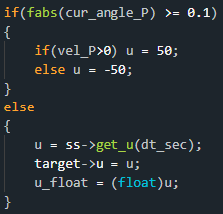
Porting State Feedback into Controller
Main Control Algorithm
X1 : Pendulum velocity X2 : Motor velocity X3 : Pendulum Angle
Swing-Up Move
Stabilizing Move

Slide 12
Code Explanation
Class
thread_encoder : 엔코더 카운트 및 각도 계산, 모터 구동을 담당하는 스레드 클래스.
thread_serial : 시리얼 플로팅을 담당하는 스레드 클래스.
StateSpace : State Space 모델링 및 모터 명령 값 계산 클래스. thread_encoder 내부에 내장됨.

Slide 13
Code Explanation
Class
encoder_thread_rotor
Angle_R
encoder_thread_pen
thread_serial
Angle_P
Angle_R
Serial_PC
StateSpace
u1, u2, u3
PC
u
Motor Driver

Slide 14
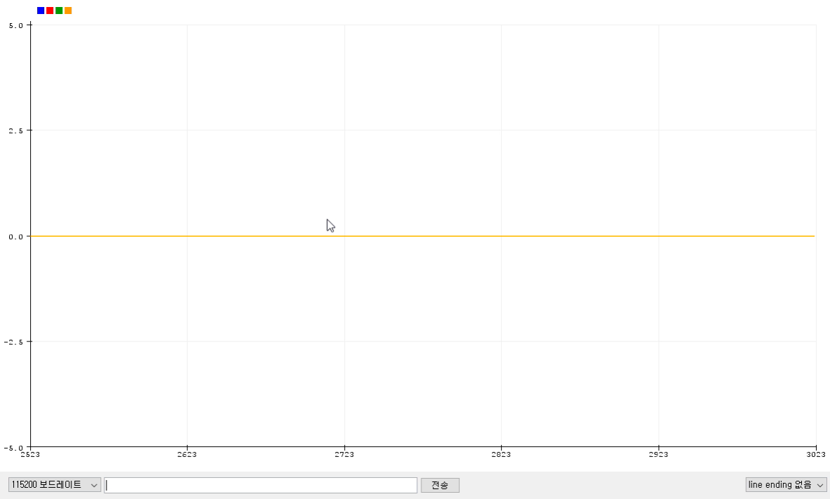
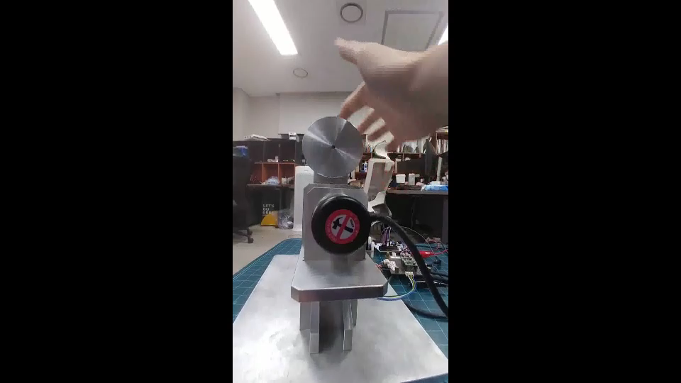
Result
Result

Slide 15
Result
Conclusion
시간이 부족해 세부적인 튜닝 및 Swing-Up 동작까지는 테스트를 못함.
정상상태 에러를 보정할 만한 추가적인 수단이 필요해보임.

